Slide 1

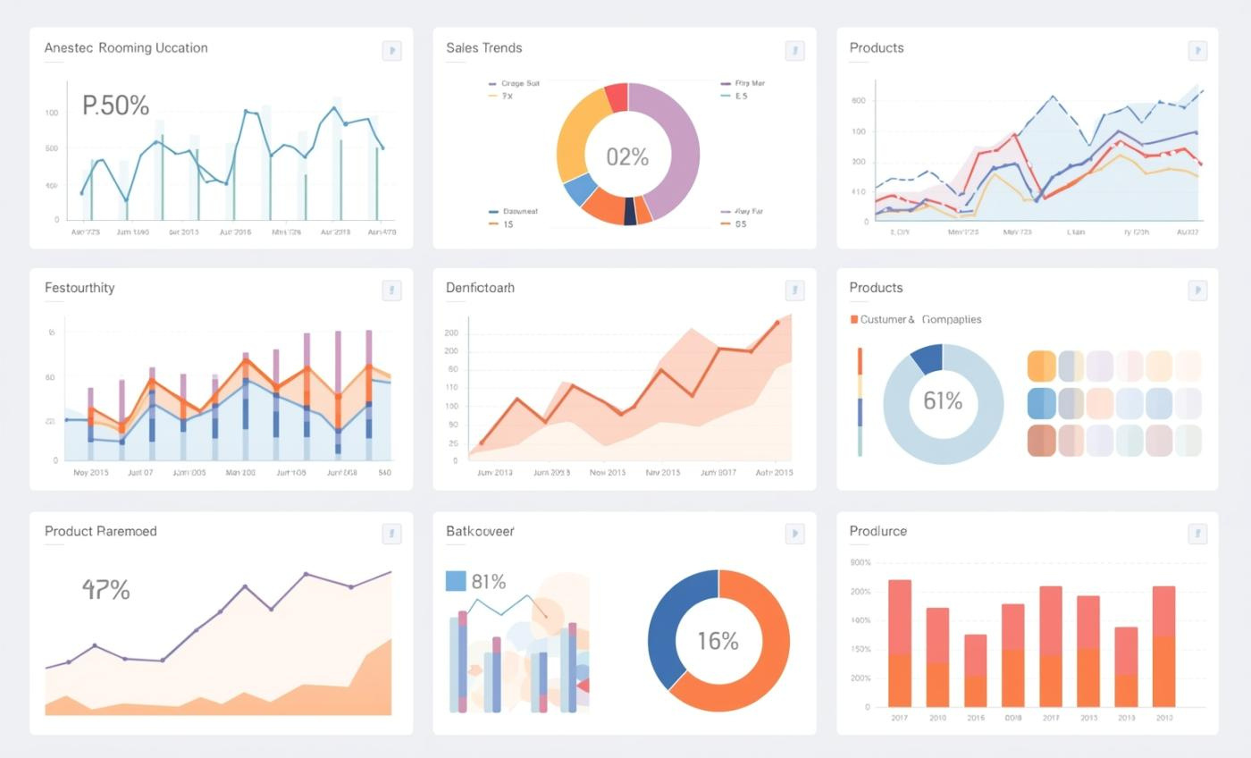

E-commerce Dataset Analysis
Presented by
Sanju Devi .S

Slide 2
Introduction and Objectives
Analyzing customer behavior and trends
This analysis aims to comprehend customer behavior, identify key sales trends, and assess product performance, utilizing SQL and Python for informed, data-driven decisions in e-commerce.

Slide 3
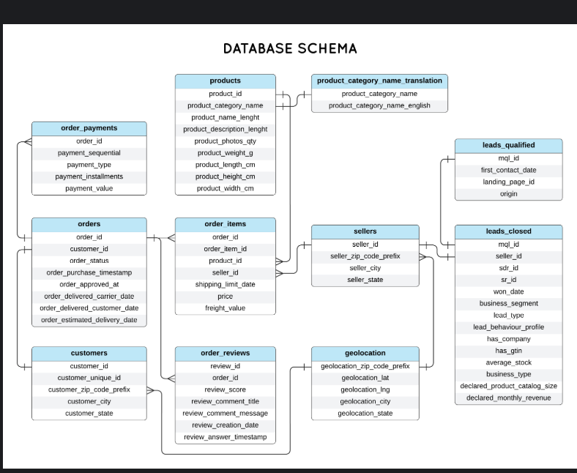
Dataset Overview
E-commerce Transactional Records Analysis
This dataset includes comprehensive transactional records from our e-commerce platform, featuring key tables such as Customers, Orders, Products, and Payments, spanning multiple years of data.

Slide 4
SQL Analysis Approach
Data Extraction and Aggregation Techniques
This section outlines the essential SQL techniques for efficient data extraction, filtering, and aggregation, enabling comprehensive analysis of e-commerce datasets to derive actionable insights.

Slide 5

Key Findings
This section highlights critical insights derived from SQL analysis, focusing on total sales and revenue categorized by product types. Understanding these findings is essential for identifying high-performing categories and informing strategic decisions to enhance overall e-commerce performance.

Slide 6
📦 ORDER PERFORMANCE ANALYSIS
Delivered: 96,476 → 97.02%
Approved: 99,281 → 99.83%
Purchased: 100%
💡 Insight:
Purchase to approval almost perfect.
Delivery rate is strong (97%) — but 3% gap still exists (returns, cancellations, logistics issues).

Slide 7
🚚 DELIVERY PERFORMANCE
📊 Average Delivery Delay: -11.17 days
Negative means → orders delivered before estimated date
Min Delay: -146 days (extremely early)
Max Delay: +188 days (extremely late)

Slide 8
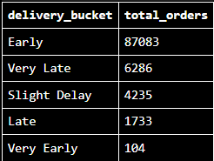
💡 Insight:
Majority deliveries are early (very good logistics).
But ~8% orders are late/very late → this likely impacts bad reviews.

Slide 9
🏪 SELLER ANALYSIS
🔝 Top Sellers by Orders:
6560211a19b4... → 2033 orders
4a3ca9315b74... → 1987 orders
1f50f920176f... → 1931 orders
🔝 Top Revenue Sellers:
4869f7a5dfa2... → 206K revenue
53243585a1d6... → 200K revenue
💡 Some sellers high revenue but not highest orders → means higher priced products.

Slide 10
🛍️ TOP REVENUE CATEGORIES
🥇 Watches & Gifts
🥈 Health & Beauty
🥉 Bed, Bath & Table
🏅 Sports & Leisure
💡 These are the most profitable segments.
Low revenue categories like books, drinks, signaling etc → niche market.

Slide 11
⭐ REVIEW ANALYSIS
Total Reviews: 99,224
⭐ 5 Star → 57,328
⭐ 4 Star → 19,142
⭐ 3 Star → 8,179
⭐ 2 Star → 3,151
⭐ 1 Star → 11,424
📊 Average Rating: 4.08 / 5
Sentiment Split:
Good (4 & 5): 77.06%
Neutral (3): 8.24%
Bad (1 & 2): 14.68%

Slide 12
⚠️ IMPORTANT BUSINESS INSIGHT
Bad reviews: 14.6%
Very Late deliveries: 6,286 orders
👉 Strong possibility: Late deliveries causing low ratings
Example:
Some reviews say:
"Não chegou meu produto"
"Nada de chegar o meu pedido"
Means product didn't arrive or was delayed.

Slide 13
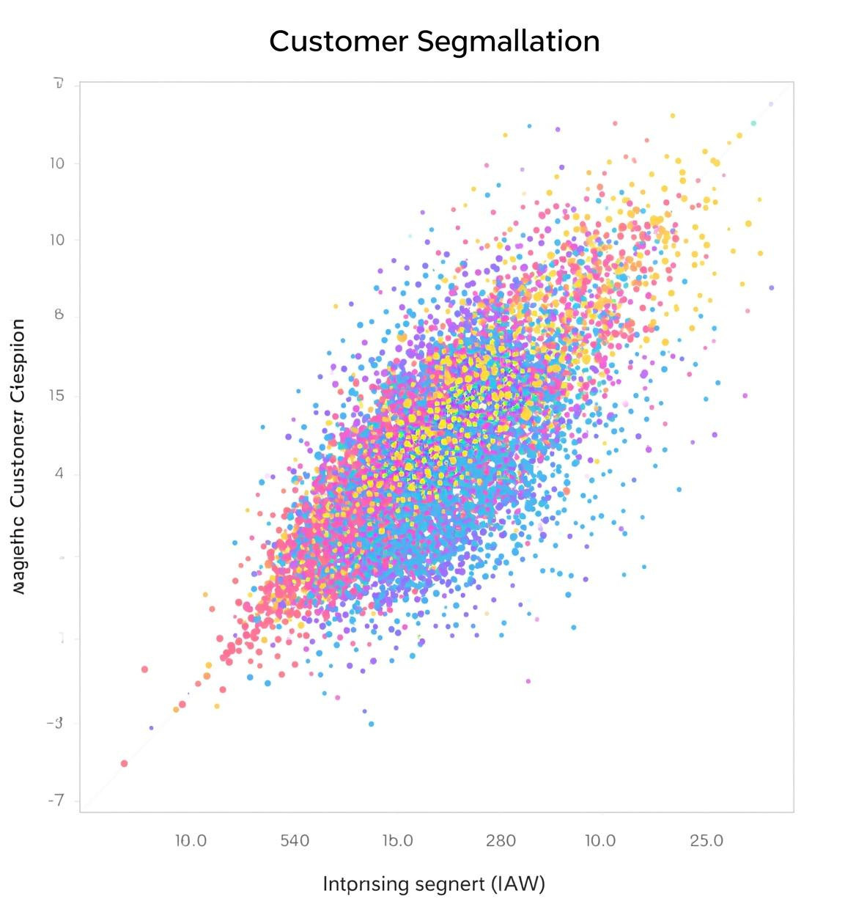
🎯 Strategic Recommendations
1️⃣ Improve Late Delivery Cases
Focus on the 6,286 very late deliveries.
2️⃣ Monitor High-Volume Sellers
High order sellers = high complaint potential.
3️⃣ Category Optimization
Invest more in:
Watches
Health & Beauty
Sports
4️⃣ Customer Service Follow-up
Auto follow-up emails for:
Slight Delay
Late
Very Late

Slide 14

Recommendations
Marketing Strategies
Inventory Management
Target top customer segments to maximize engagement and conversion rates effectively.
Adjust inventory levels based on real-time sales trends and forecasts for efficiency.
Product Recommendations
Payment Processes
Enhance product suggestions using data-driven clustering results to boost sales.
Improve checkout efficiency to reduce cart abandonment rates and increase completed transactions.

Slide 15
Summary and Conclusion
The value of data-driven decisions
✔ Platform performing well overall
✔ Strong delivery efficiency
✔ High average rating (4.08)
⚠ 14% negative reviews need attention
⚠ Some sellers generating majority complaints
If you want, I can now:

Slide 16

Questions & Discussion
Email
hello@reallygreatsite.com
Social Media
@reallygreatsite
Phone
123-456-7890

Slide 17
thank you

